Slide 1


Developing Embedded Software for EagleSat 2 MDE
Nikhil Dave, Tyler Thurman
Mentor: Ahmed Sulyman
Department of Computer, Electrical, and Software Engineering
College of Engineering
Embry-Riddle Aeronautical University – Prescott

Slide 2
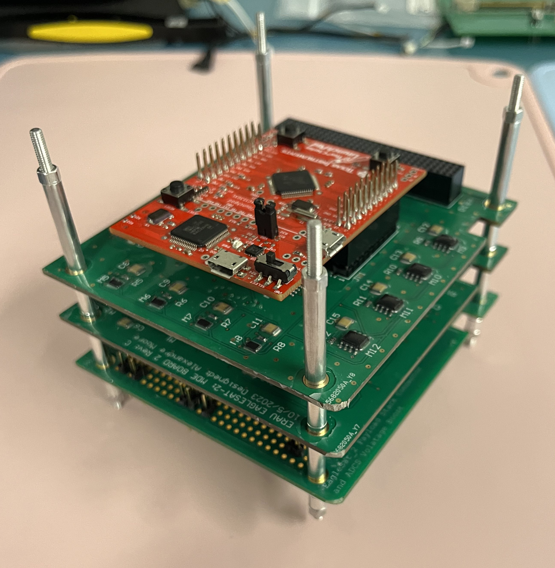
Background
EagleSat 2 – 3U CubeSat developed by students at ERAU
Memory Degradation Experiment (MDE) - scientific payload
Test operation of computer memory in space
Software mostly written but needs testing and bug fixing
Flight MDE hardware
Notes:
To start, EagleSat 2 is a 3U CubeSat (30x10x10 cm) designed, built, programmed by students at ERAU Prescott
The Memory Degradation Experiment, or MDE, is the scientific payload for EagleSat 2
MDE tests how various types of computer memory in space. Specifically, it measures how resilient NOR Flash, Ferroelectric Random Access Memory, Magnetoresistive RAM, and Static RAM are to bit flips from cosmic rays.
For those who don't know, high energy particles in space can cause data held in computer memory to flip.
Most of MDE is completed – hardware is done, and software is mostly complete. We are mostly working on integration, testing, and debugging

Slide 3
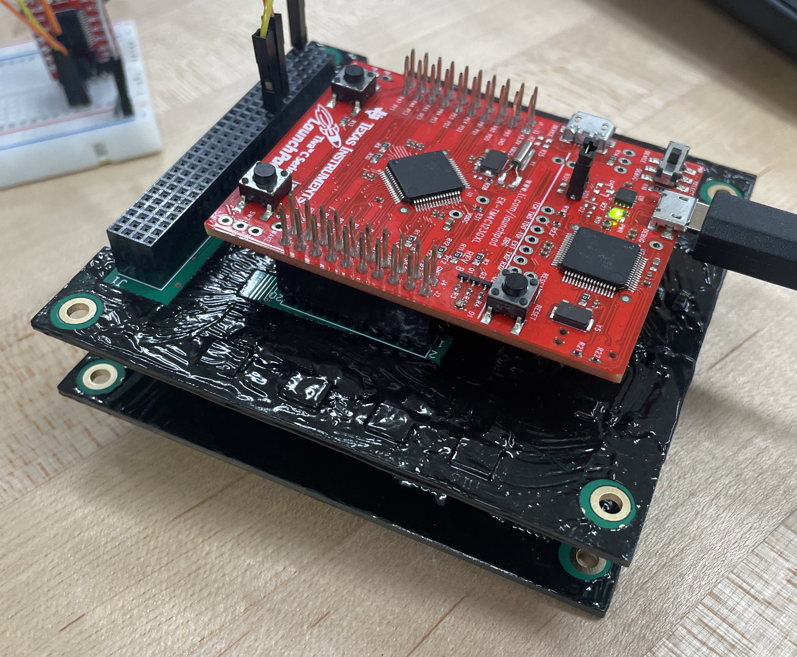
Objectives
MDE is an embedded system
Debugging embedded software is difficult
Main goal: Ensure MDE is flight-ready by end of school year
Develop testing methods to confirm MDE meets its requirements
Development MDE hardware
Notes:
Our main goal is to ensure that MDE is flight-ready
To do this, MDE software must meet its requirements.
In order to verify the above, we need to have methods to test the software to ensure the requirements are met.

Slide 4
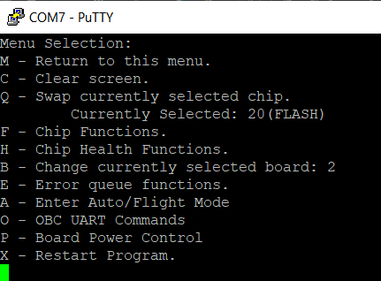
Methods
A serial USB debugging menu
Logic analyzers - inspect signals
Serial data terminal - mimic the main satellite computer
Top-Level Debug Interface
Notes:
The main tool we used was a debugging menu accessed over a USB connection.
With this, we could manually trigger parts of the software, such as writing to a single memory chip. The menu allowed us to check that individual parts of the program behaved as desired.
We also used Logic Analyzers – tools to view electrical signals and interpret them as information – to check the communication between MDE's processor and the memory chips
Finally, we occasionally used a serial data terminal to mimic the main satellite computer for testing communications.

Slide 5
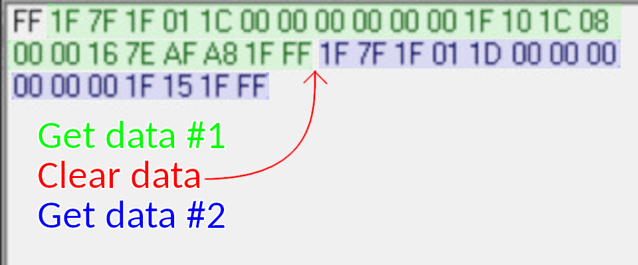
Results and Analysis
Minimal working version of the software complete
Current efforts on optimizing and bug fixing
Debug menu invaluable for testing
Signal analysis can be used to verify hardware correctness
MDE responding to commands
Notes:
Using the debug menu, signal analysis, and serial console, we have a working version of MDE's software completed.
The image on the left is a screenshot of the serial console in which MDE sends data containing chip health data and a detected error (inserted using the debug menu) - the green highlight.
Then, I sent the command to clear MDE's data buffer before requesting the data again. This time, in blue, MDE returned chip health data, but it there was no error data to send.
At this point, the only software left is a way to determine if a chip is dead while attempting a write, and fixes to the way we normally check chip health.
The debug menu has been invaluable for us. It enables testing of individual software components and allows us to avoid known issues or unimplemented functions.
With the signal analysis and serial console, we can analyze behavior of normally opaque systems, clarify/confirm command characteristics, familiarize with controllers and chips

Slide 6
Summary
EagleSat 2 MDE – comparing data integrity of various types of computer memory in space
How to effectively develop and test embedded software?
Debugging menu
Signal Analysis
Serial communication terminal
Above tools vital to achieving MDE software completeness
Confirming robustness is vital in unmaintainable applications

